Slide 1
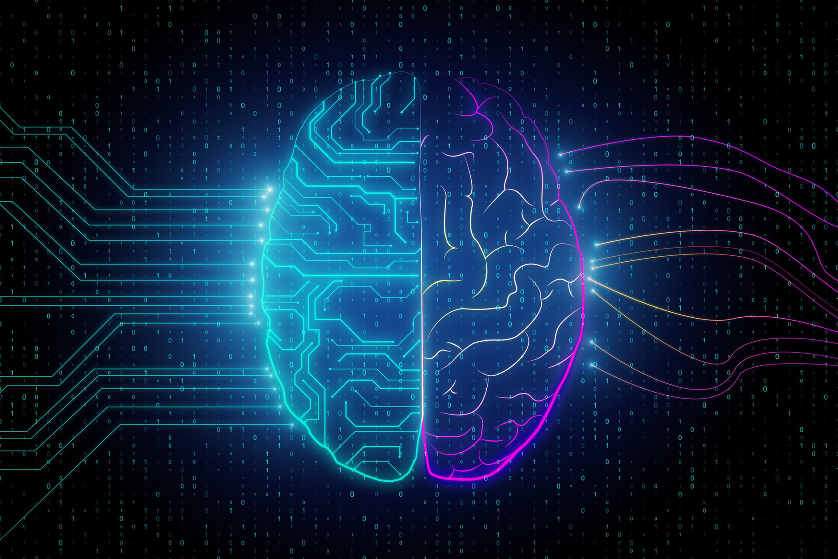











OMAD-Brain Tumor Detection
Darsh Thakkar - 60017210040 Abhay Mathur - 60017210016 Omar Shaikh - 60017210088 Mahir Madhani - 60017210019
Guide: Mr. Nilesh Rathod

Slide 2




Problem Statement
Use Machine Learning and Deep Learning models to detect brain tumours in MRI/CT scan images with improved accuracy and also to identify and detect possible symptoms of brain tumours very early.

Slide 3
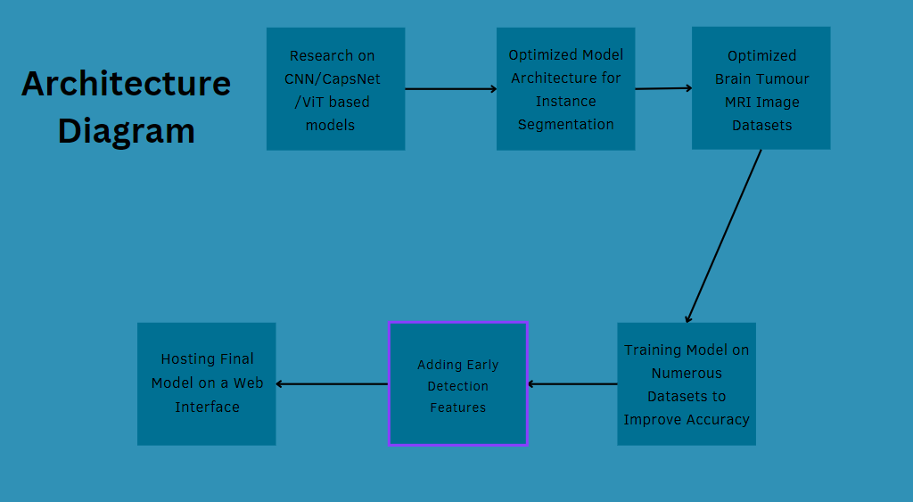

Slide 4
Aim
Our aim is to increase the accuracy of existing Brain Tumour Detection models by experimenting with more expansive datasets and newer and cutting edge image segmentation model architectures along with use-case optimized deep learning algorithms. We also aim to work on identifying early symptoms of brain tumours and how we can detect them using Machine Learning.

Slide 5

Implementation
We explored multiple semantic and instance segmentation models (YOLOv8, SAM, FastSAM, etc.) and tried to train multiple datasets on them to figure out the model that gives the most accuracy. We found out that YOLOv8-seg is the only model that we have found so far that can be trained and finetuned for segmentation and therefore provides the best accuracy. We also tried to use a dataset called BraTS dataset to train our yolov8seg model but it is in .h5 files. We managed to convert those .h5 files to .nii files and view them, they are 3D images with a lot of statistics of MRIs of brain images. We are now trying to find a way to train our yolov8seg model on the 5GB BraTS dataset. Currently we have trained our yolov8seg model on a Brain Tumour Detection dataset curated by Celebal we found on roboflow. We have achieved 92.9% accuracy (0.929 mAP50)

Slide 6
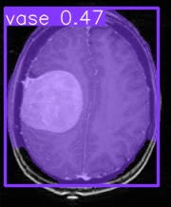
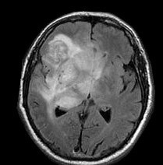
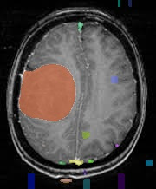
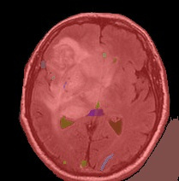
Implementation
YOLOv8-seg before training:
SAM before training:

Slide 7
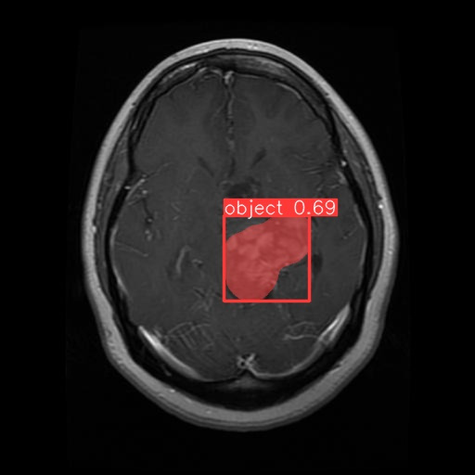
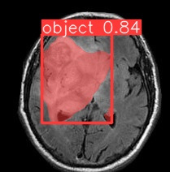
Implementation
YOLOv8-seg after training:

Slide 8
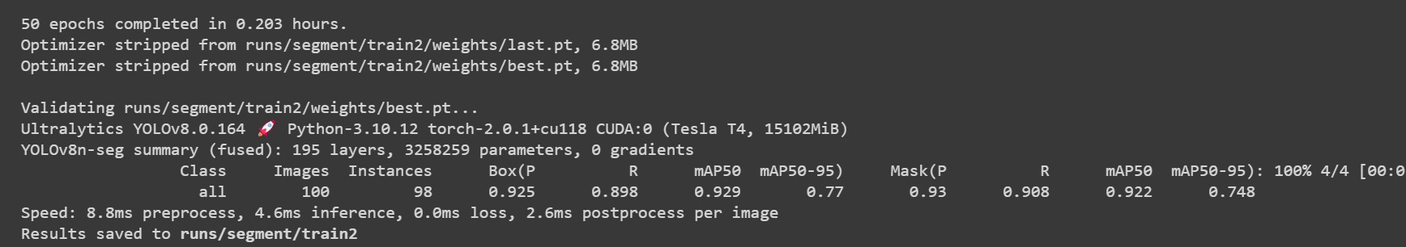
Results
YOLOv8-seg after training:
Link to Training Colab File

Slide 9



SCOPE OF THE PROJECT
Our Goal
Creation of an automated approach for improving, segmenting, and categorising brain tumours.
Usage of this system by Neurosurgeons and other healthcare professionals
The system uses computer vision, pattern analysis, and image processing techniques, and it is anticipated to increase the sensitivity, specificity, and effectiveness of screening for brain tumours.
Medical imaging projects' main objective is to accurately and meaningfully extract information from these images with the least amount of inaccuracy.
The development of auxiliary tools that can aid in early diagnosis or the
monitoring of tumour identification and locations is made possible by the right combination and parameterization of the stages.

Slide 10
Conclusion
Brain Tumours are an ever-increasing medical problem and this field has an immense scope of research work in terms of detection automation.
After conducting thorough research and surveying multiple articles and papers about brain tumour detection we have come to the conclusion that the most optimal way to do this is by trying to implement various cutting edge methods and models of instance segmentation such as YOLOv8 and various new and unexplored Deep Learning models based on the base architecture of Convolutional Neural Networks (CNNs) such as CapsNet. ViT, etc.

Slide 11




The End

